Slide 1

Foreign Direct Investment Analysis
-By Swapnil Mane

Slide 2
Introduction
Investment is a game of understanding historic data of investment objects under different events but it is still a game of chances to minimize the risk we apply analytics to find the equilibrium investment.
This is the Foreign direct investment in India for the 17 years from 2000-01 to 2016-17

Slide 3
Details of Data
Dataset contains –
1. Sectors (Total 64 sectors)
2. Years (Total 17 years)
3. FDI Values

Slide 4
Key Insights
Factors Influencing FDI
Meaningful Relationship between Attributes
Sector – specific Insights
Recommendations of Equilibrium Investment

Slide 5
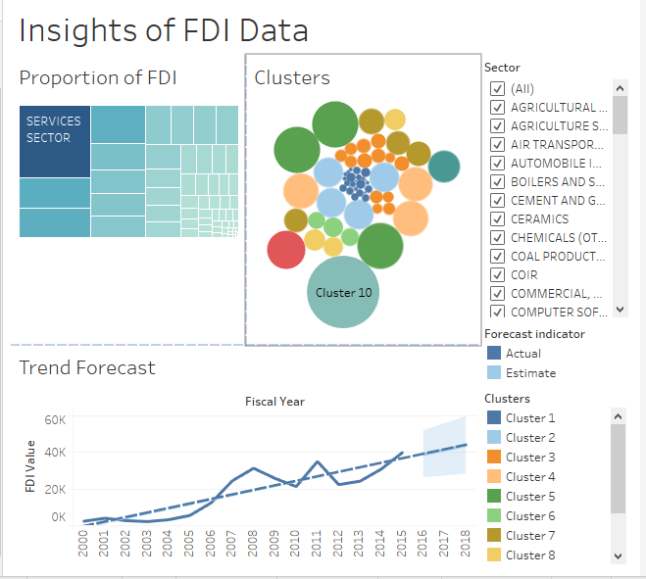
Dashboards

Slide 6
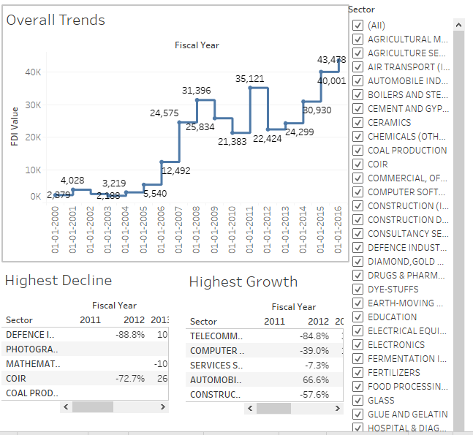

Slide 7
THANK YOU !

